Slide 1
Prediction of used Volkswagen Golf price
With Python, Pandas, NumPy, plotly, sklearn

Slide 2
Plan of work
Import VW Golf database
Use different ML models to predict car price
Chose of the best model and summary of work

Slide 3
About the imported database
The database consists of:
- 95 different columns with information about car specs, engine, and equipment,
- 3335 rows where one row is a unique car with its values,
- datatype prepared to Machine Learning

Slide 4
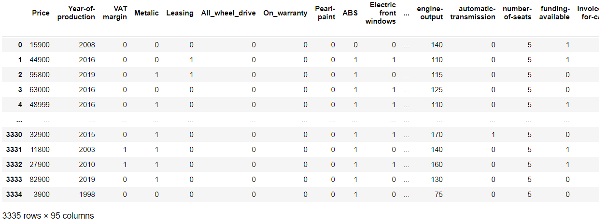
Import the database of used VW golf

Slide 5
Import the database of used VW golf

Slide 6
Random Forest Regressor
criteria | R2 Score | Difference BETWEEN PREDICTED AND TRUE car PRICE
Mean Squared Error | 0.92 | 40 Euro
Mean Absolute Error | 0.91 | 20 Euro

Slide 7
Regression
Type | R2 Score | Difference BETWEEN PREDICTED AND TRUE car PRICE
Linear | 0.85 | -60 Euro
Ridge | 0.85 | -60 Euro

Slide 8
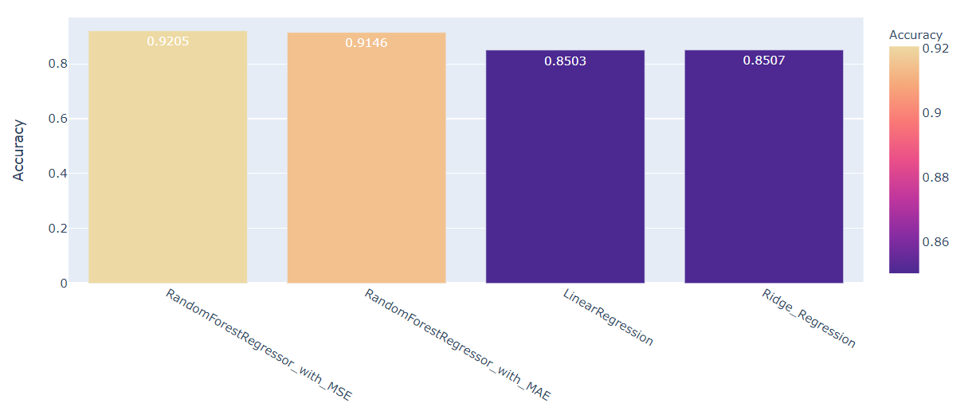
Summary OF MODELS ACCURACY

Slide 9
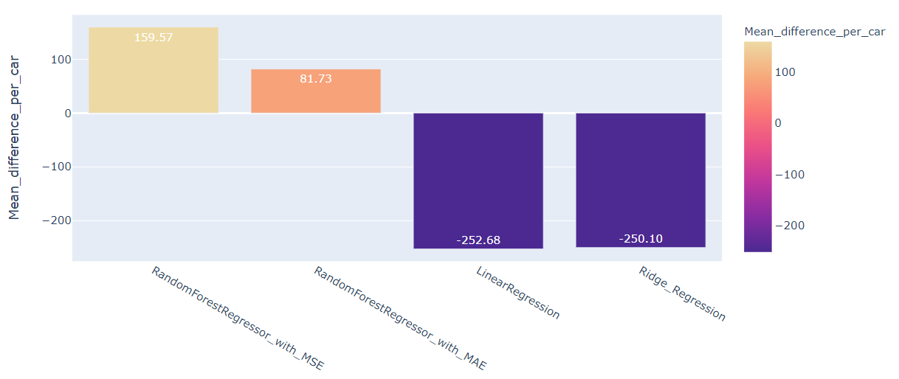
Summary OF difference between predicted and true car price

Slide 10
CONCLUSIONS
- The best model for predicting the price of Volkswagen Golf is RandomForestRegressor with the mean absolute error criteria,
- This model has more than 85% of accuracy,
- Selected model predict on average 82 PLN (20 EUR) higher car price than it is real, which makes the dealer not lose money on car sales.

Slide 11
Contact Us
LinkedIn JANXBITTNER
EMAIL janxbittner@gmail.com

